Slide 1
SEPM Project Title – Electronics Mart

Slide 2
Introduction
Purpose -
Electronic Mart is a Web-Application whose requirements are mentioned in this document, this is the first version of the application. It is a User-Friendly E-commerce website it will enable customers to browse the products efficiently. The administration module will enable system administrators to manage products, orders and users.
Product Scope –
Secure registration & profile management facilities for customers with the additional functionality of 2-factor authentication.
The adequate searching mechanism for easy & quick access to particular products.
Creating a Shopping cart so that customers can shop 'n' no. of items and checkout finally with the entire shopping cart. Customers can add or delete items in the cart.
Regular updates to registered customers through a newsletter about Sales, Amazing Deals and New Arrivals.
Showing the products with customer ratings in each category.
Maintaining a database of customers with their interested categories of products.
Administrators are responsible for internal affairs like processing orders, updating orders’ status and managing products.
Customers can give ratings & reviews for the product which they have purchased & used (or delivered to them).
Adequate payment mechanism and gateway for all popular credit cards, cheques and other relevant payment options.

Slide 3
Feasibility Analysis
1. Technologies
a. All the required technologies should be working in the system.
b. If some software is not working, find solutions for them.
c. The technologies should be in trend and should be in use for some more years
2. Resources
a. All resources like database should be working
b. Device must be able to support the development
3. Data
a. Data should be available to be displayed on the website.
b. If not, then find APIs for Data
c. In case there are no available APIs, add data manually into database

Slide 4
Software Requirements Specification(SRS)
Electronics Mart

Slide 5
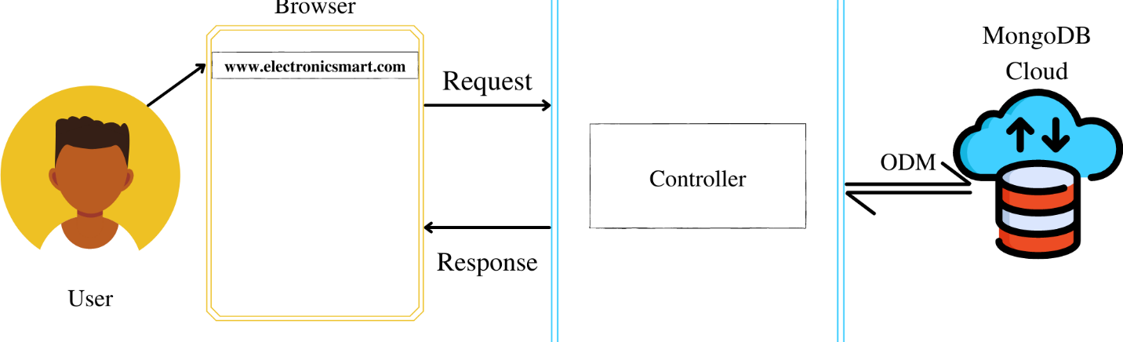
Product Perspective
Electronic Mart is a Web-Application, it is a User-Friendly E-commerce website it will enable customers to browse the products efficiently. This website is intended to be a new, self-contained product and should depend on the availability of mongo cloud, Heroku servers. It should be able to run on any device which supports a browser.

Slide 6
Product Functions
Customers can search products by category, name, ratings and price range.
After successful login Customers can add & edit items in the cart.
Customers can also view the status of any previous orders & cancel any order that has not been shipped yet.
Customers can modify personal profile information (such as name, phone No., email & other details) & can enable or disable Two-Factor Authentication for additional security.
Admins can manage products, orders and users.

Slide 7
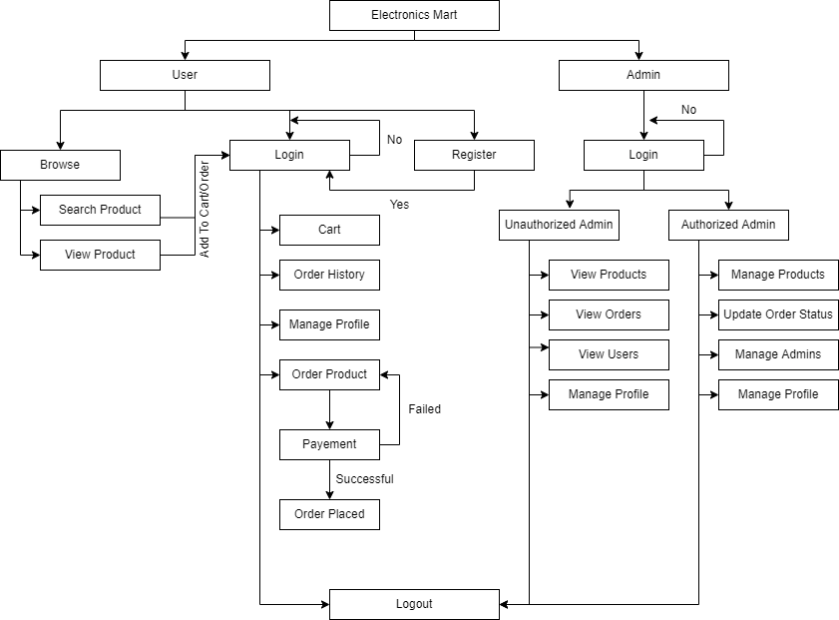
Flow of the Website

Slide 8
Design and Implementation Constraints
The website application should be lightweight & simple API.
The database should be able to manage a huge amount of data and should have a flexible schema with sharding (basically horizontally scalable) so the preferred database language is Mongo DB.
Mongo Atlas should be used for storing data on the cloud has 10GB storage & 2GB RAM.
Programming language for backend – Node JS and framework – Express JS.
Programming language for frontend – HTML 5, CSS3, JavaScript.

Slide 9
User Documentation
The product will include a user manual. The manual will include a product overview, complete configuration of the software (such as Mongo DB server and other technologies used), technical details, backup procedure & contact information which will include an email address. The product will be compatible with any browser and the database will be created in Mongo DB.
Assumptions
The system should be user friendly so that it is easy to use for the users.
The Electronics Mart is a 24X7 running website except for the servers where application & database are deployed & stored goes down.
Users can access Electronics Mart from any device which supports a web browser and an internet connection.
Dependencies
The Servers due to which the web application will run.
The Payment process is dependent on the payment plugin while purchasing the product.
The Information of all users must be stored in a database that is accessible by the Electronics Mart system.

Slide 10
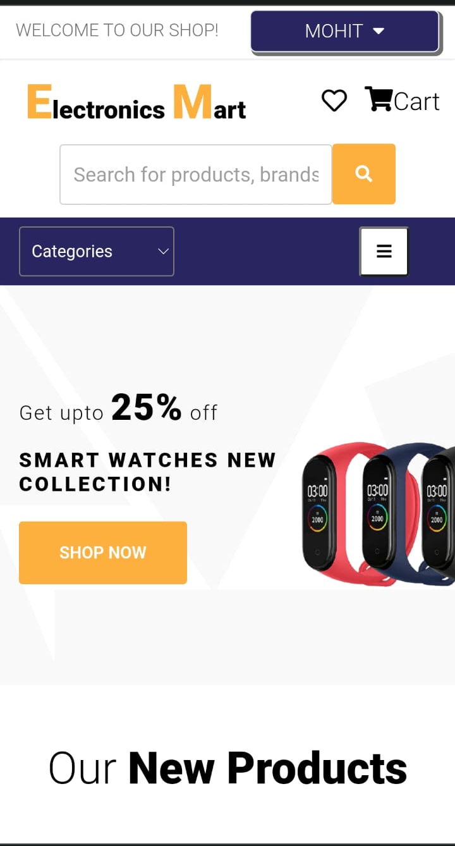
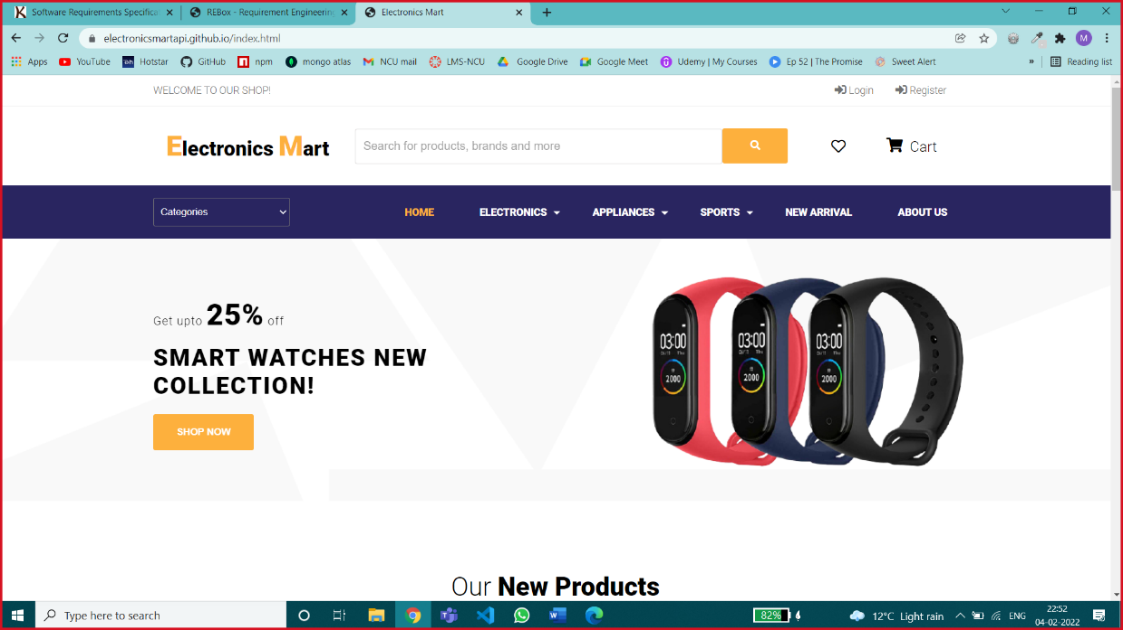
User Interface
Home Page – Customers can view products on this page.

Slide 11
Hardware Interfaces
Any Hardware Device that supports the following Browsers will be able to run Electronics Mart – Good Data is tested against and supports the following desktop browsers:
Google Chrome, Firefox, Microsoft Edge or any supported browser that you choose to use must meet the following requirements:
JavaScript is enabled.
Cookies are enabled.
Software Interfaces
Databases – Mongo DB is managed by Mongo Atlas on the cloud.
Operating System – Windows /Mac or any other OS which can execute Node JS.
Tools – Postman for testing Backend Application, Github Desktop.

Slide 12
System Features
Authentication - This feature will help company to identify user uniquely. So, this plays a crucial rule in the system hence having high priority.
Browse & Search Products - This is one of the most important features of the website which enables the customer to browse products in an optimized way, hence having high priority.
Order Products - This feature will help logged in users to order any product in stock.
Manage my Account - This feature will allow logged in user to view, update, delete account.
Manage my Cart - This feature will allow logged-in users to add, delete items in the cart.
Manage Products - This feature will allow logged-in admins can add, update, delete products after successful login.
Manage Admins - This feature will allow logged in authorized admins to view admins, authorize/unauthorize admins / delete admins.
Manage Users - This feature will allow logged-in admins to view & search users in an optimized way & delete any user if required.
Rate & Review products – This feature will allow logged users to rate & review products so that they can share their experiences of using products with other buyers.
Newsletter Service - This feature will allow users to receive newsletter emails from the website & logged in admins to send newsletter emails & view previous newsletter emails.

Slide 13
Non-functional Requirements

Slide 14
Performance Requirements
Minimize redirects on your site by frontend AJAX call through which user will get required data without redirecting.
Use of projection will remove unnecessary data like createdAt, updatedAt, etc. while sending data from backend to frontend which will reduce size of data to be transferred & therefore less loading time, hence achieving better performance.
Use separate database to store images & save the links of images in there corresponding objects which will enhance performance because the images will only load when end user visits the website & will not travel from database to controller & then controller to frontend.
Use Indexing on product search as it will gives result faster than normal searching.
Safety Requirements
Maintain a backup of data because in case database server gets crashed or something else happen data could be recovered easily.
Continues Monitoring is required for proper maintenance of website, in case load on website is at its peak the servers should be upgraded by vertical or horizontal scalability as per requirement & we are using a distributed system so it can be achieved easily.
Security Requirements
The password must be encrypted while saving in data base.
The token-id should expire after 2 Hours.
A middleware should be plugged in before other routes which requires user’s details for authentication which will authenticate users because we hare using HTTPS protocol which is connectionless.

Slide 15
Software Quality Attributes
Testing: The software should be tested for both backend, frontend & after integrations another integration testing should be performed.
Updates: Updates can be easily managed and joined with distributed node JS system.
Portability: The software should be portable from one device to another i.e., laptop, mobile, etc.
Availability: The software is 24X7 available except backend servers may get crashed for that we may deploy the website’s backend on different servers after dividing into different nodes so that whole application doesn’t go down only one or two functions may not work in case server gets crash.
Business Rules
User will get mailed on every login so if it’s not the user then the user must change the account password for security as soon as possible.
The admin has rights to delete any users account if the user is violating any rules.
The admins can update order status and can cancel the order in case the product is unavailable due to some reason.
If a user cancels any order, then the product quantity, he cancelled should get added to original product quantity.

Slide 16
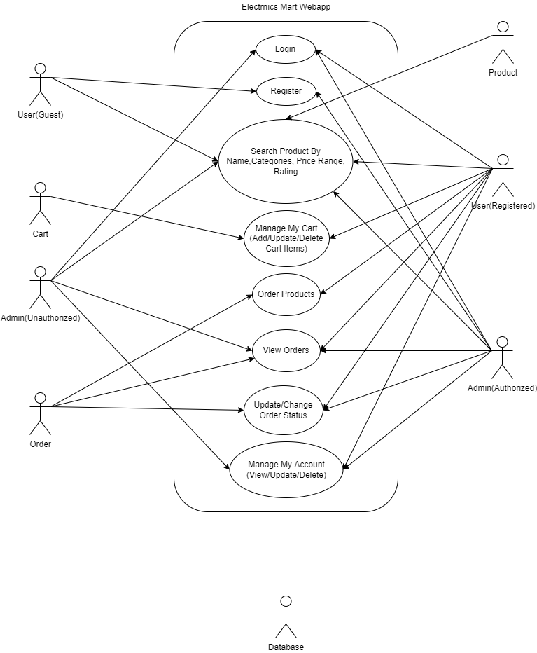
Use Case Diagram
The purpose of a use case diagram in UML is to demonstrate the different ways that a user might interact with a system.

Slide 17
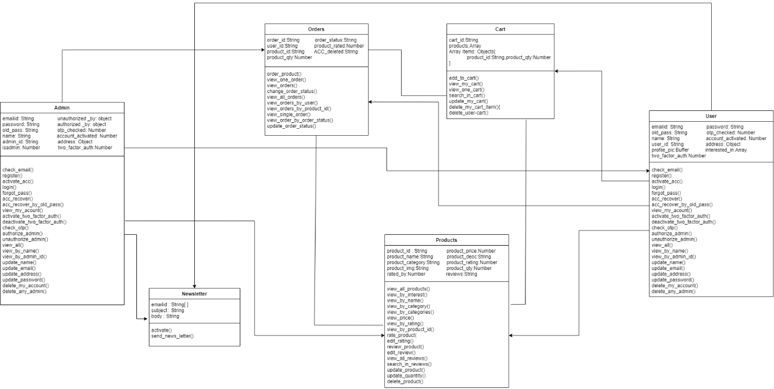
Class Diagram – A class diagram in the Unified Modeling Language (UML) is a type of static structure diagram that describes the structure of a system by showing the system's classes, their attributes, operations (or methods), and the relationships among objects.

Slide 18
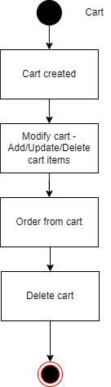
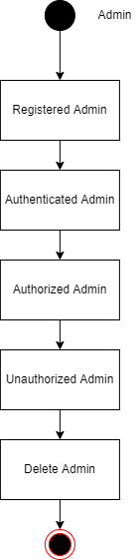
State Diagram
A State diagram is a type of diagram used in computer science and related fields to describe the behavior of systems.

Slide 19
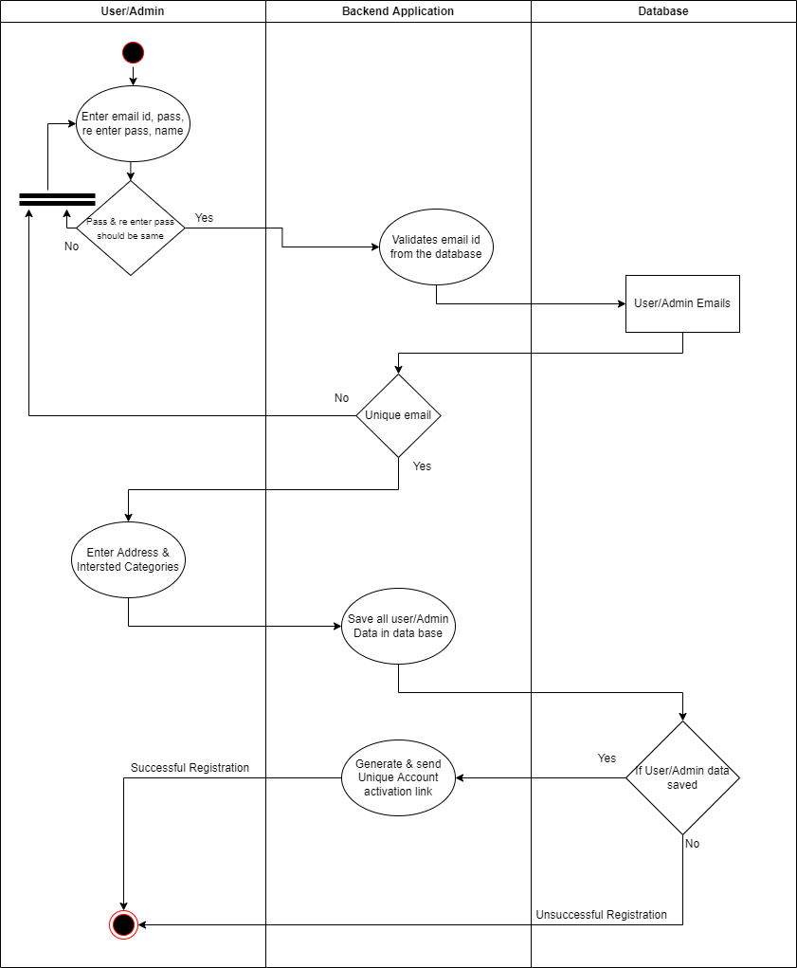
Activity Diagram
Activity diagram is basically a flowchart to represent the flow from one activity to another activity. The activity can be described as an operation of the system.

Slide 20
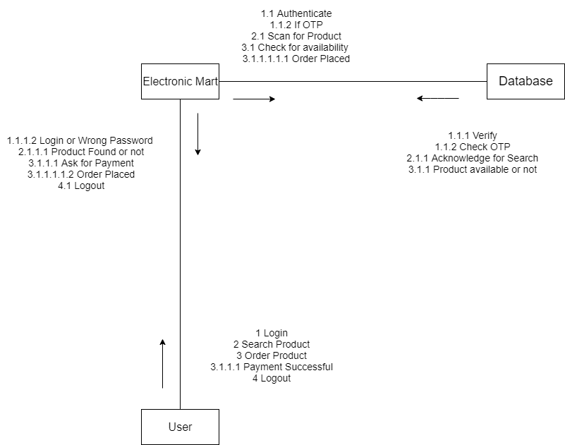
Sequence Diagram
A sequence diagram is a type of interaction diagram because it describes how-and in what order-a group of objects works together.

Slide 21
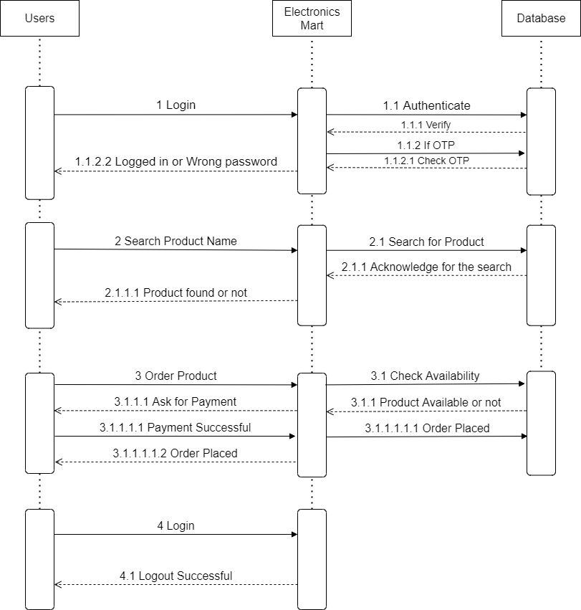
Collaboration Diagram
The collaboration diagram is used to show the relationship between the objects in a system. Both the sequence and the collaboration diagrams represent the same information but differently. Instead of showing the flow of messages, it depicts the architecture of the object residing in the system as it is based on object-oriented programming.

Slide 22
Black Box Texting –
Black box testing is a type of software testing in which the functionality of the software is not known. The testing is done without the internal knowledge of the products.
The steps for carrying out Black Box Testing are as follows:
At first, the application to be tested is studied to find out the requirements and specifications. The SRS (Software Requirement Specification) document should be maintained with accuracy.
The inputs and test scenarios are evaluated. Efficient and time-saving techniques are incorporated.
Test cases are generated. These test cases are made in such a way that the input range is maximum.
The test cases are then processed to obtain the output. The generated output is compared with the expected output to understand the success of the result.
If there are unsuccessful steps, they are sent to the software development teams for fixing.
The defects are fixed.
Run the tests again for confirmation.

Slide 23
Test ID | Input | Observed (colour/time) |  |  |  | Expected (colour/time) |  |  |  | Result | Remarks
 |  | North | East | South | West | North | East | South | West
1.1 | 0 | Green/27 | Red/30 | Red/60 | Red/90 | Green/27 | Red/30 | Red/60 | Red/90 | Pass | Good
1.2 | 1 | Green/26 | Red/29 | Red/59 | Red/89 | Green/26 | Red/29 | Red/59 | Red/89 | Pass | Good
1.3 | 13 | Green/14 | Red/17 | Red/47 | Red/77 | Green/14 | Red/17 | Red/47 | Red/77 | Pass | Good
1.4 | 26 | Green/1 | Red/4 | Red/34 | Red/64 | Green/1 | Red/4 | Red/34 | Red/64 | Pass | Good
2.1 | 27 | Yellow | Red/3 | Red/33 | Red/63 | Yellow | Red/3 | Red/33 | Red/63 | Pass | Good
2.2 | 28 | Yellow | Red/2 | Red/32 | Red/62 | Yellow | Red/2 | Red/32 | Red/62 | Pass | Good
2.3 | 29 | Yellow | Red/1 | Red/31 | Red/61 | Yellow | Red/1 | Red/31 | Red/61 | Pass | Good
3.1 | 30 | Red/90 | Green/27 | Red/30 | Red/60 | Red/90 | Green/27 | Red/30 | Red/60 | Pass | Good
3.2 | 31 | Red/89 | Green/26 | Red/29 | Red/59 | Red/89 | Green/26 | Red/29 | Red/59 | Pass | Good
3.3 | 44 | Red/76 | Green/13 | Red/16 | Red/46 | Red/76 | Green/13 | Red/16 | Red/46 | Pass | Good
3.4 | 56 | Red/64 | Green/1 | Red/4 | Red/34 | Red/64 | Green/1 | Red/4 | Red/34 | Pass | Good
4.1 | 57 | Red/63 | Yellow | Red/3 | Red/33 | Red/63 | Yellow | Red/3 | Red/33 | Pass | Good
4.2 | 58 | Red/62 | Yellow | Red/2 | Red/32 | Red/62 | Yellow | Red/2 | Red/32 | Pass | Good
4.3 | 59 | Red/61 | Yellow | Red/1 | Red/31 | Red/61 | Yellow | Red/1 | Red/31 | Pass | Good
5.1 | 60 | Red/60 | Red/90 | Green/27 | Red/30 | Red/60 | Red/90 | Green/27 | Red/30 | Pass | Good
Test Cases for Traffic Light System

Slide 24
White Box Testing –
White box testing techniques analyze the internal structures the used data structures, internal design, code structure and the working of the software rather than just the functionality as in black box testing.
Cyclomatic Complexity –
Cyclomatic complexity is a software metric used to indicate the complexity of a program. It is a quantitative measure of the number of linearly independent paths through a program's source code.
M = E – N + 2P
where,
E = the number of edges in the control flow graph
N = the number of nodes in the control flow graph
P = the number of connected components

Slide 25
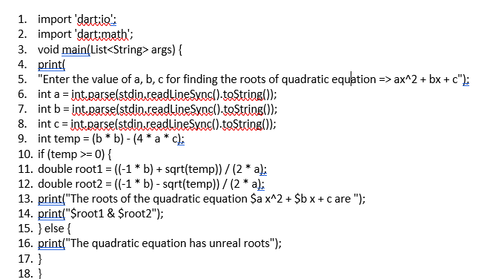
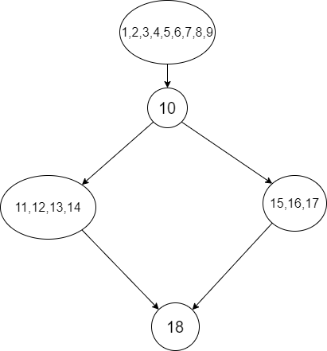
Independent Paths = E-N+2P
E = 5, N = 5, P = 1
So, independent paths = 5-5+2 = 2.
A = 1,2,3,4,5,6,7,8,9 ; B = 10, C = 11,12,13,14 ; D = 15,16,17 ; E = 18;

Slide 26
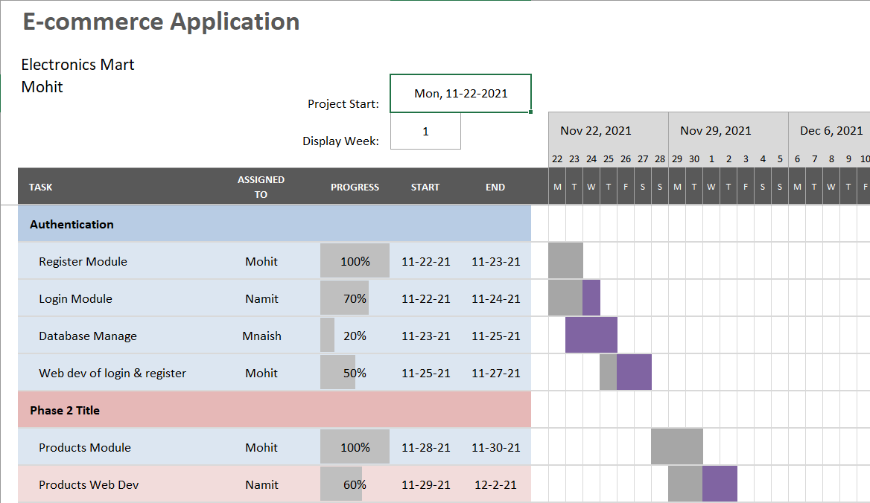
Gantt Chart
Gantt Chart for first two weeks of the project

